Slide 1
High-Performance C++ GUI Application
Asim Ahmad 548916
Hafiz Qazi Sharjeel 545050
Rayyan Ali Khan 540505
Wasi ul Murtaza Alvi 542470

Slide 2
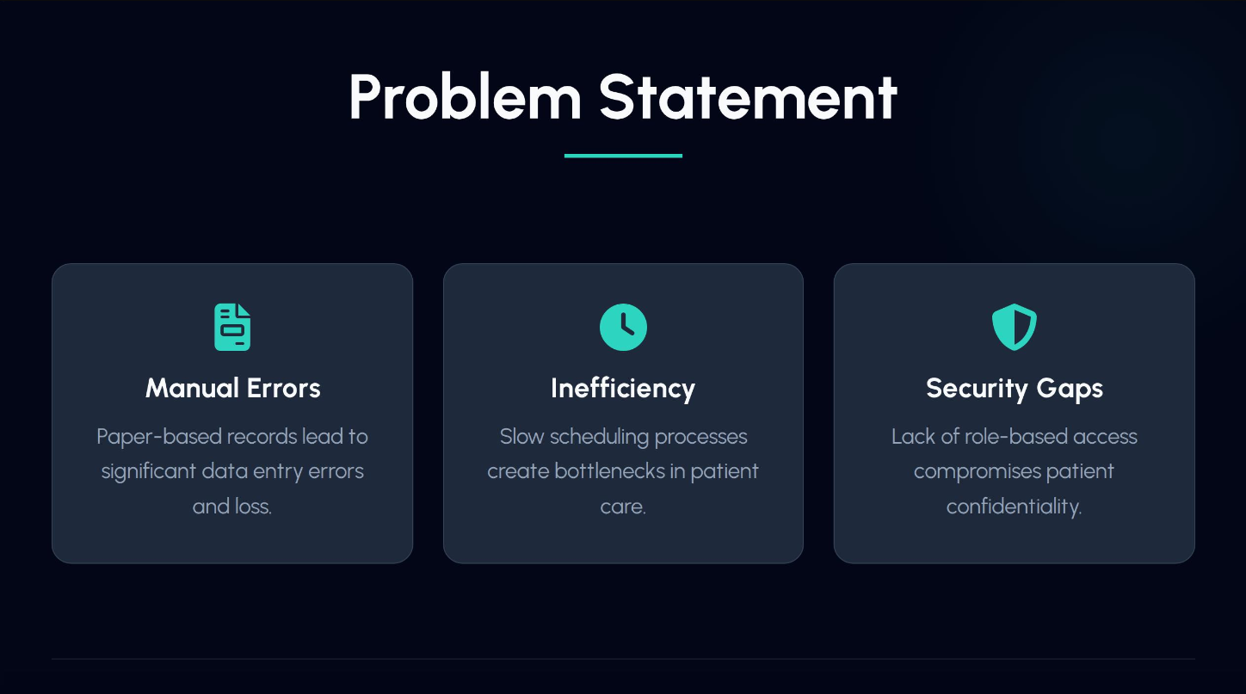

Slide 3
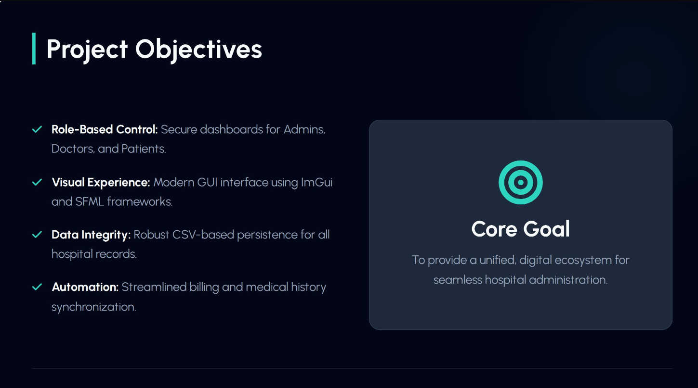

Slide 4
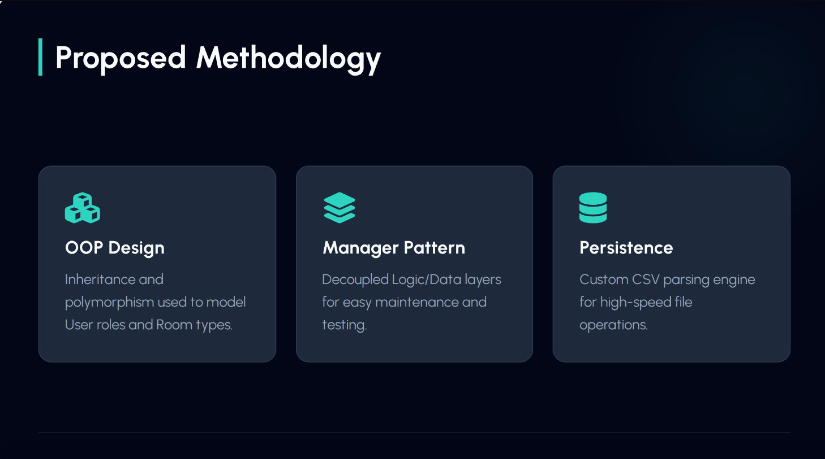

Slide 5
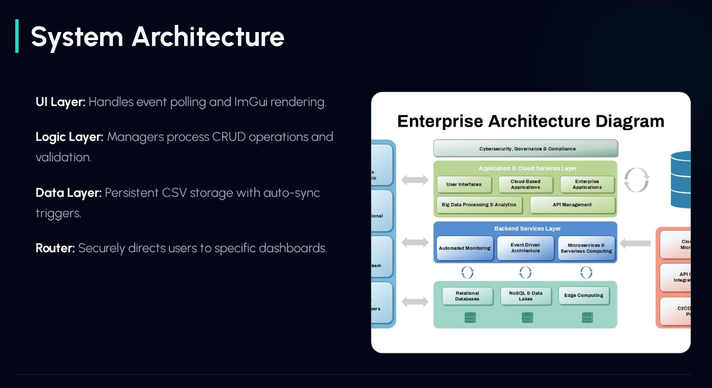

Slide 6
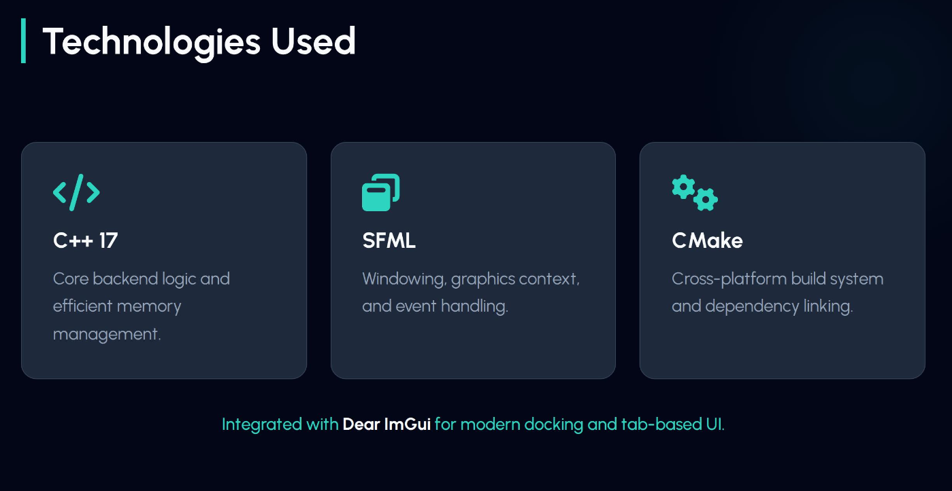

Slide 7
) Challenges Overcome
FONT ATLAS CORRUPTION
LIBR ARY LINK ING
Characters and digits (0 4-ó) were garoİed We solved
SF/v\L/ImGui Integralion hurales were solved using
this by imDlementing a Dortable font loading sequence
advanced CMake configuration and exDlicit Drefix Daths
and manual texture uDdates.
for binaries.

Slide 8
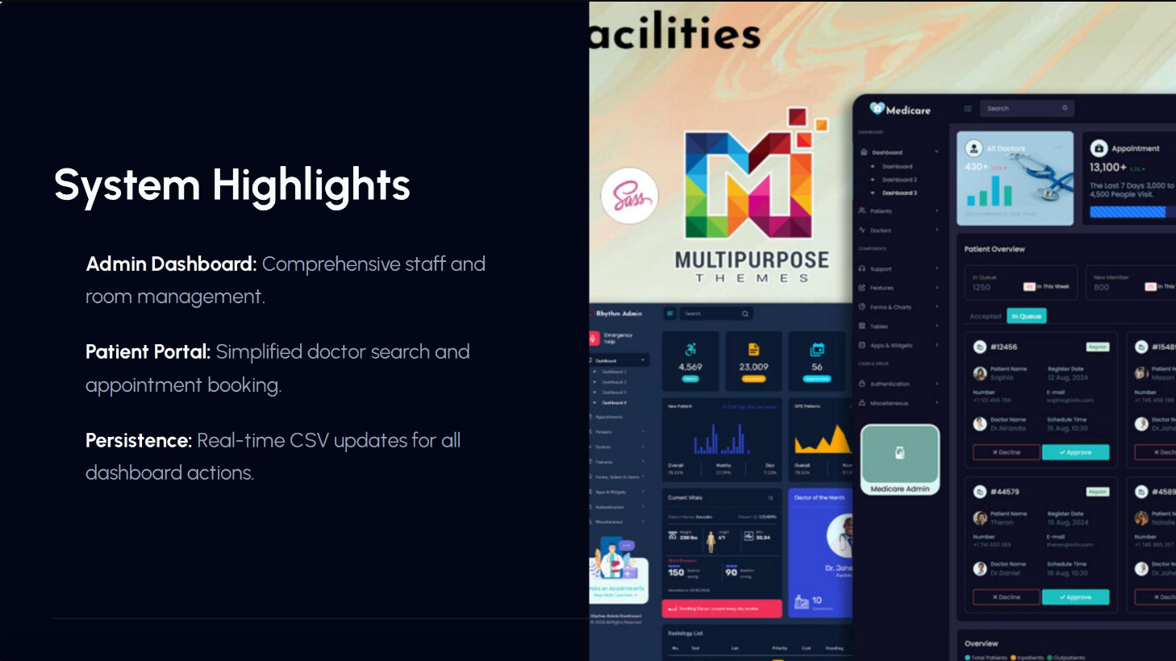

Slide 9
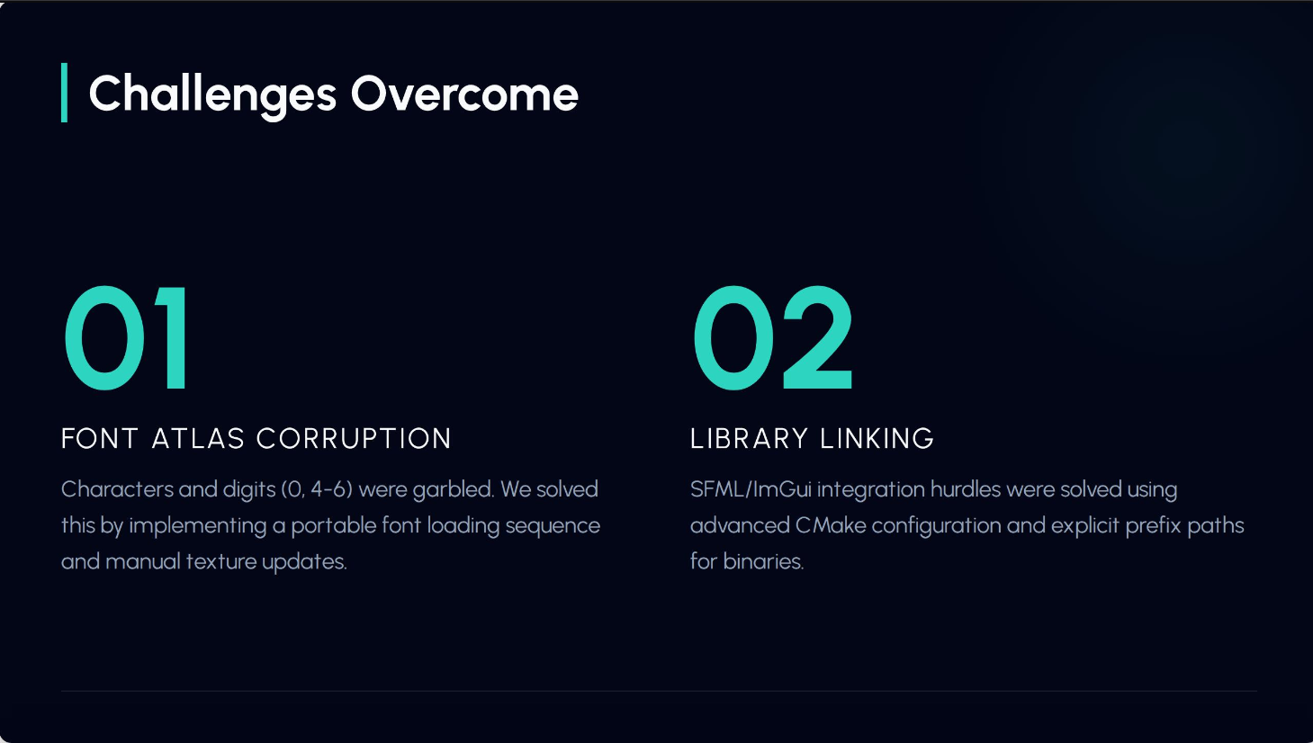

Slide 10
The floor is now open for your questions.

Slide 11
Image Sources
https://www.slidekit.com/wpcontent/uploads/2025/05/Multi-Tiered-Enterprise-Architecture-Diagram-PowerPoint-Template.jpg
Source: www.slidekit.com
https://multipurposethemes.com/wp-content/uploads/2024/10/Powerful-Dark-Mode-Hospital-Dashboard-for-Medical-Facilities-1-1200x675.jpg
Source: multipurposethemes.com

